Slide 1
Programming Fundamentals
Dr. Abdul Aziz
Assistant Professor & HoD
Department of Software Engineering
NUCES-FAST, Karachi.

Slide 2
Elements of a language
Character Set: Alphabets
Grammar: The rules of language
Sentences: Meaningful element created with the help of Characters and Grammar.

Slide 3
Elements of Computer Language
Character Set
Keywords
Data Types
Syntax

Slide 4
Character Set
ASCII - American Standard Code for Information Interchange
Standard data-encoding format for electronic communication between computers.
ASCII assigns standard numeric values to letters, numerals, punctuation marks, and other characters used in computers

Slide 5
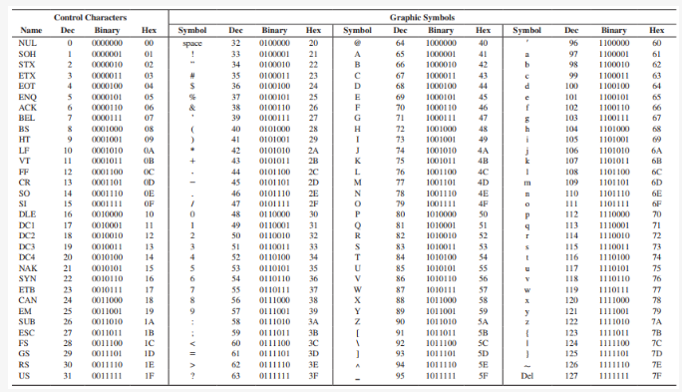

Slide 6
Keywords
Reserved words used in programming that have special meanings to the compiler.
They are 32 keywords.

Slide 7
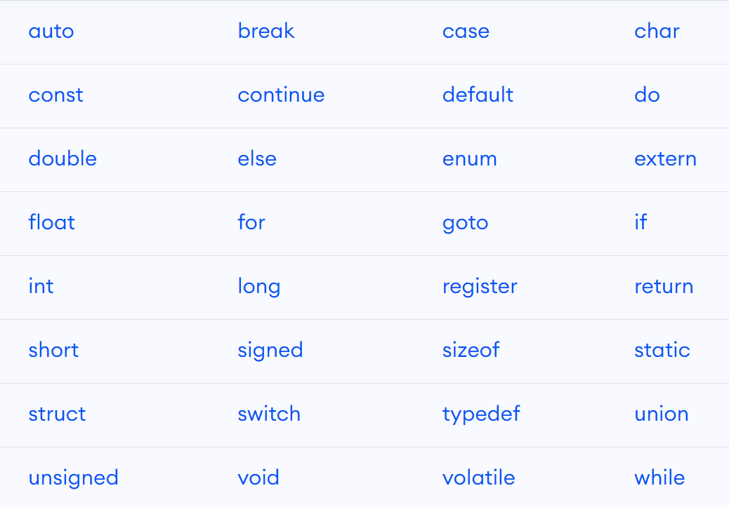

Slide 8
Data Types
Used to define variables.
Variables are define as “A temporary memory space to store data, and have a name for easy reference”.
If every thing is in binary then why data types?

Slide 9
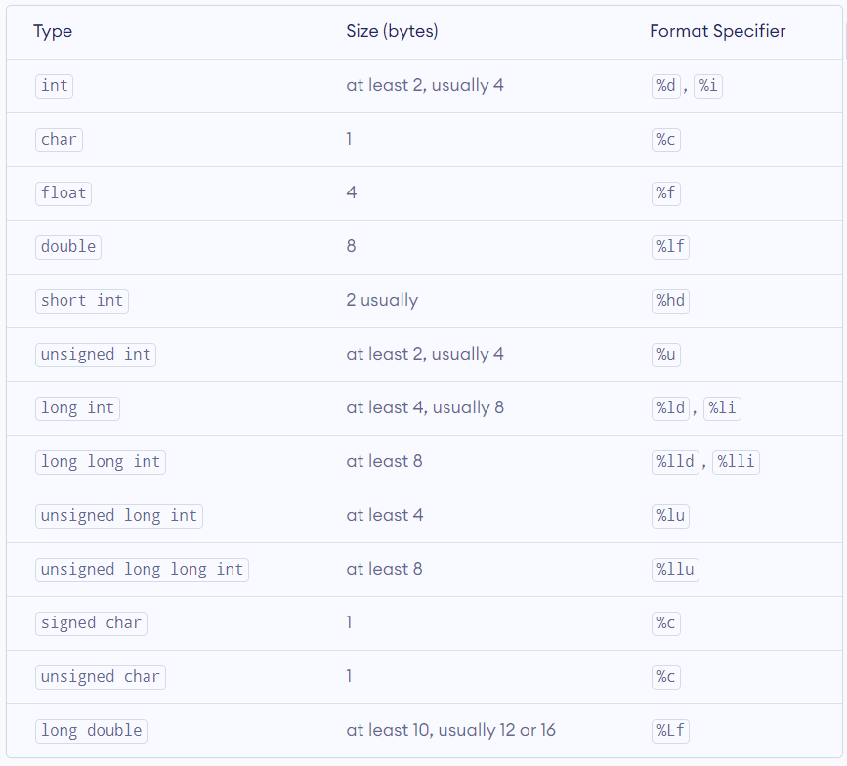

Slide 10
Syntax
Grammar .
How a specific task in done in a language.

Slide 11
Using a variable
Syntax:
Datatype Name ;
OR
Datatype Name = Value;
Example:
int var; int var =0;
char ch; char ch=‘A’;
float f1; float f1= 10.5;

Slide 12
Reading a Value from User/Keyboard
SCANF
Syntax:
scanf(“format specifier”, address of the variable);
Example:
int a=0;
scanf(“%d”, &a);

Slide 13
Escape Sequence
The purpose of the escape sequence is to represent the characters that cannot be used normally using the keyboard

Slide 14
